Slide 1
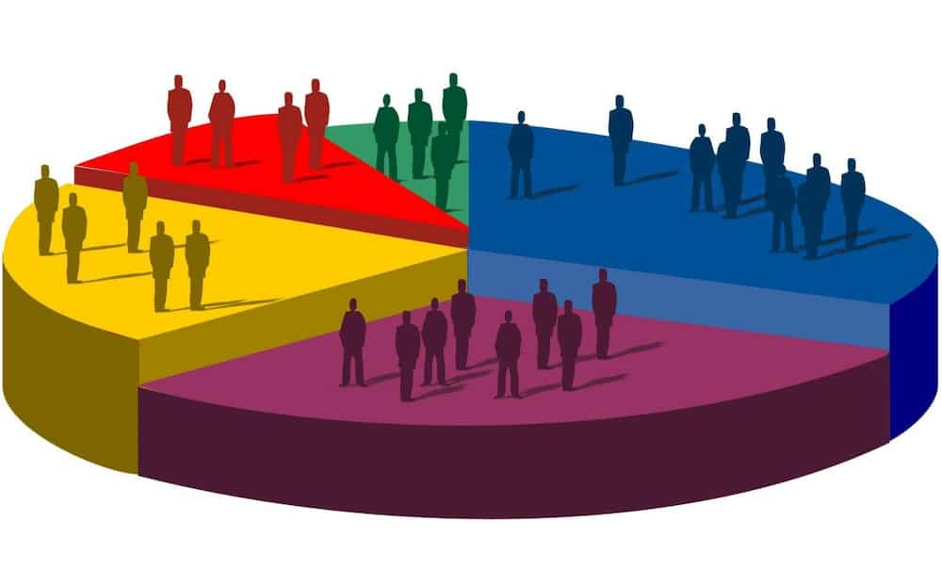
Census Data
Fundamental of Data Science
Introduction
Goals of the exercise
Tool used
Data Insight & Future Work
ID: 202236159
Name: Ojo Solomon

Slide 2
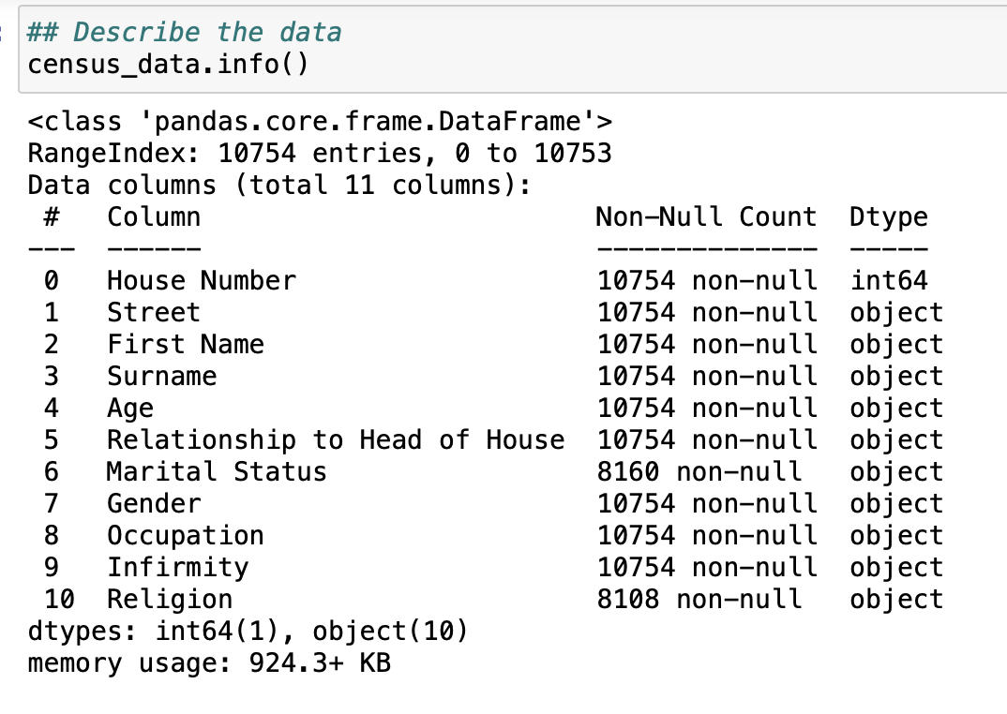
Data Description

Slide 3
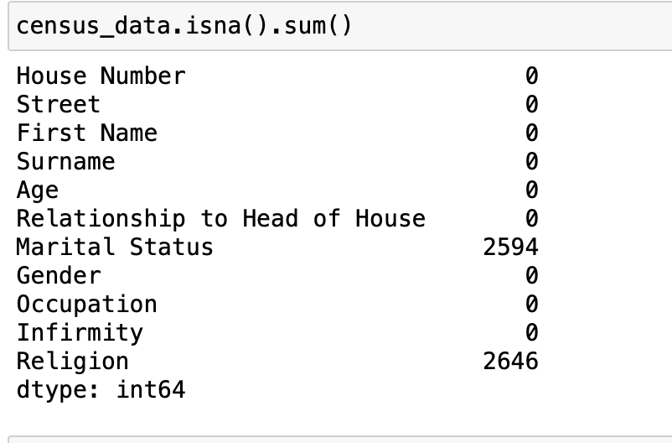
Understanding what to do
It is cler that the Marital status series and the Religion column deserve our attention

Slide 4
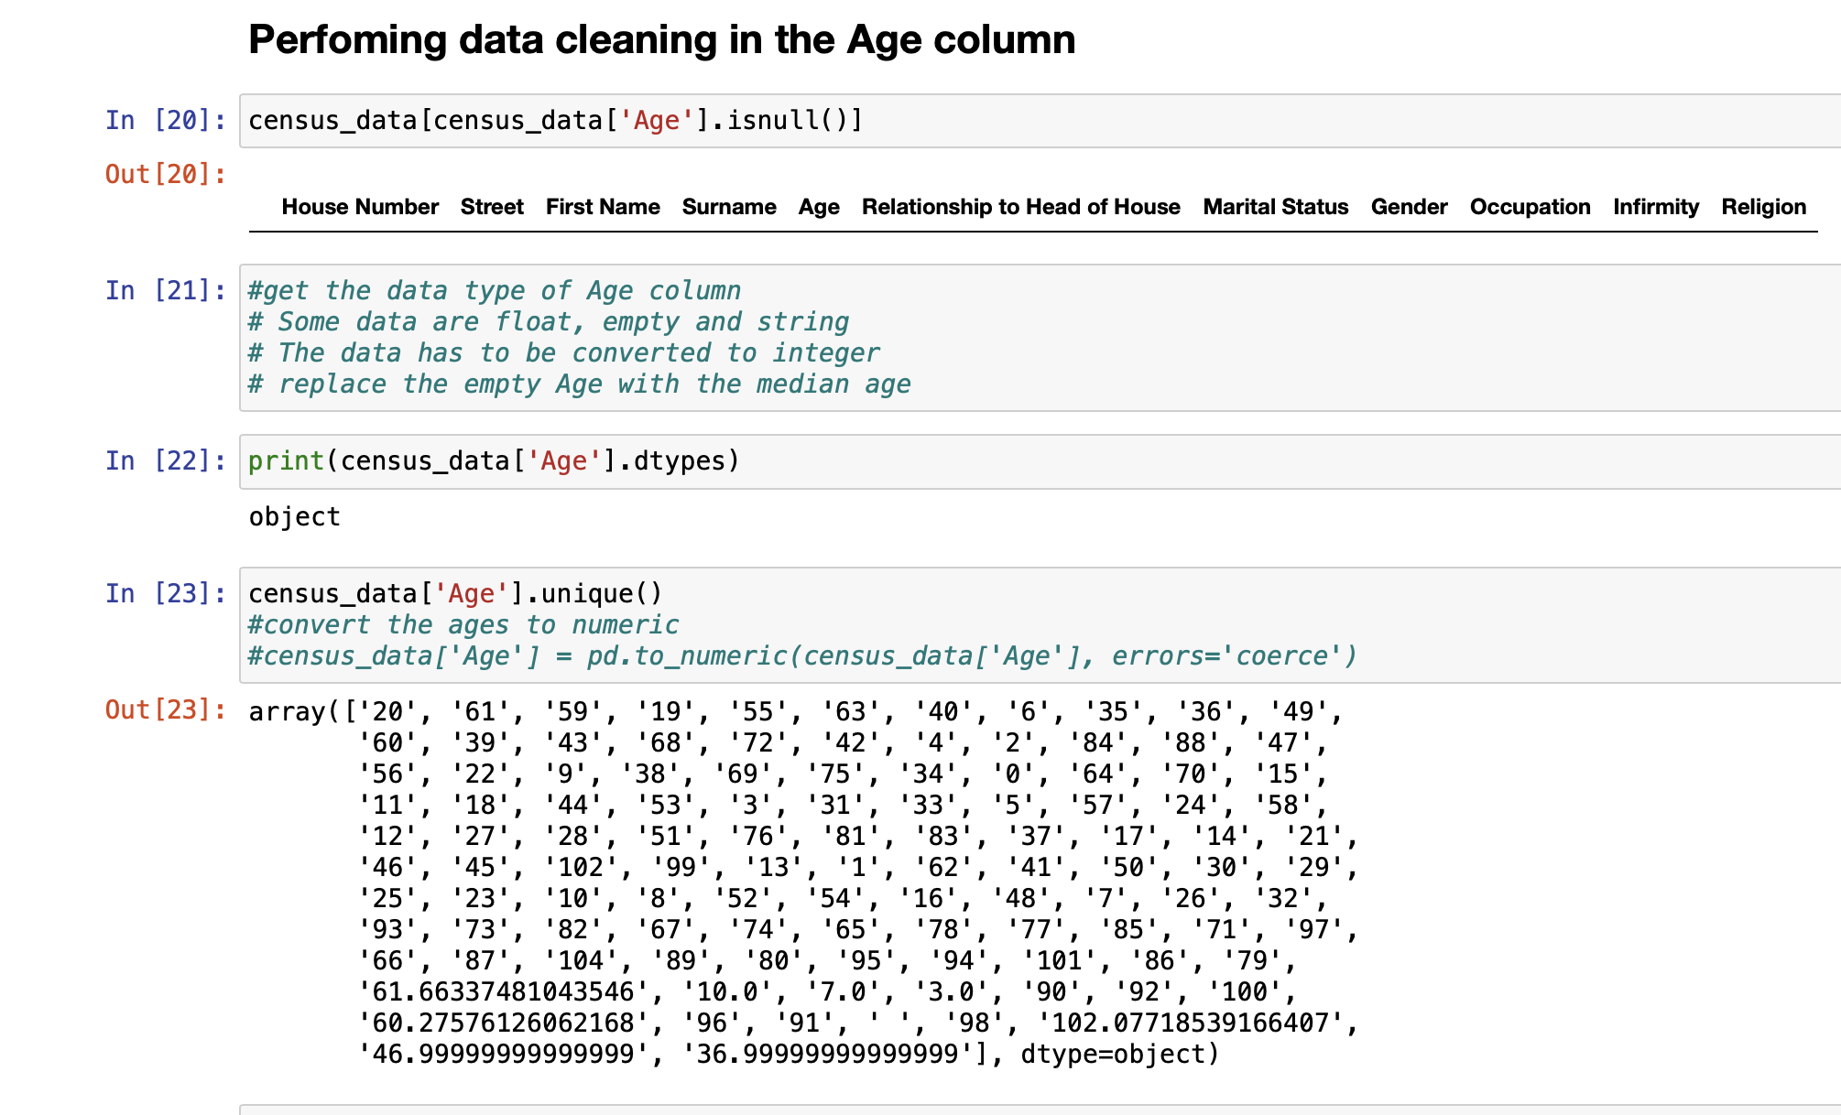
Data Cleaning on Age
Age has
Empty value
It contains float

Slide 5
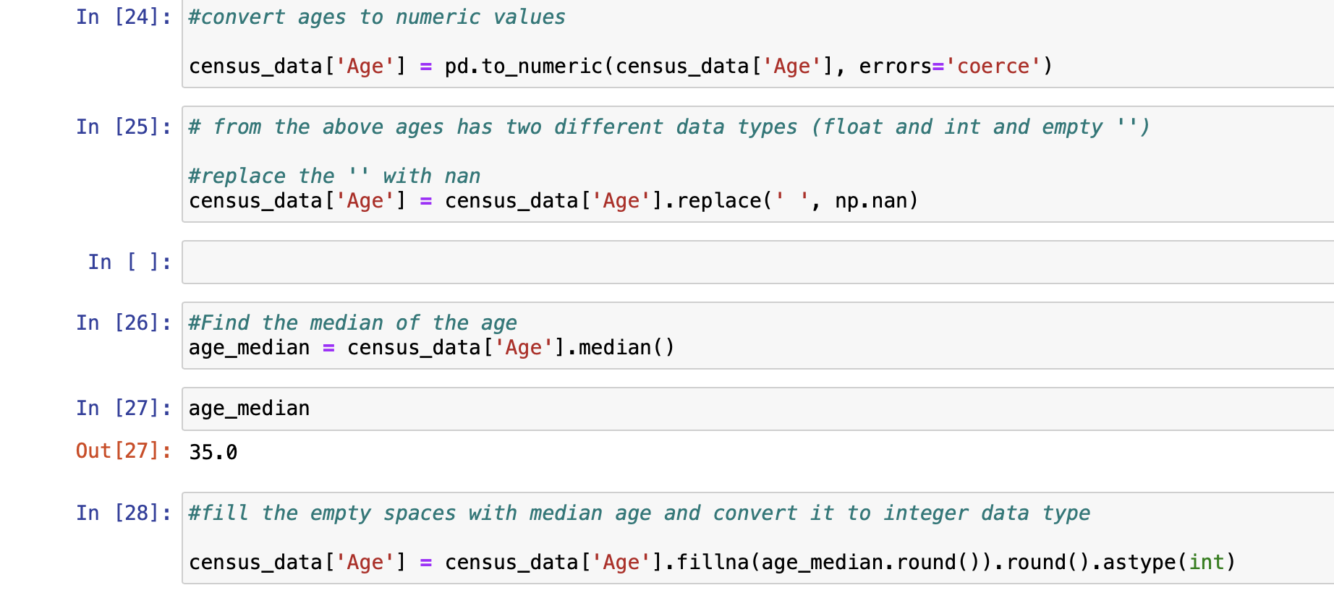
Fix Age the Column
We convert the age to integer and use median age to fill the empty age

Slide 6
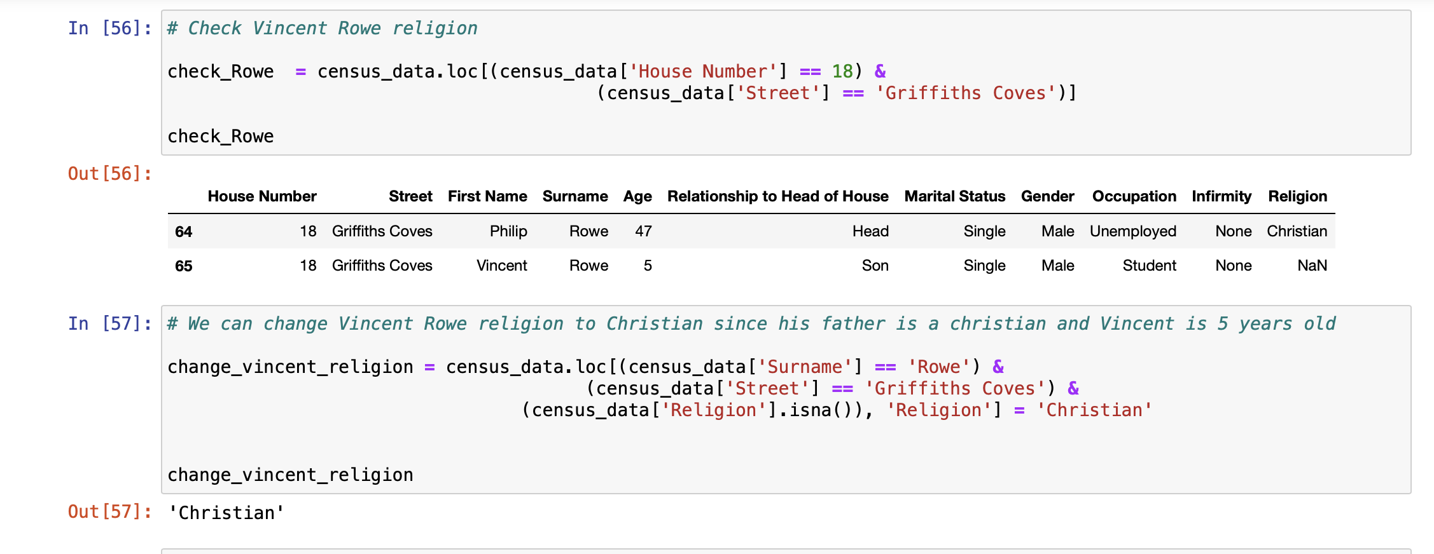
Cleaning Religion

Slide 7
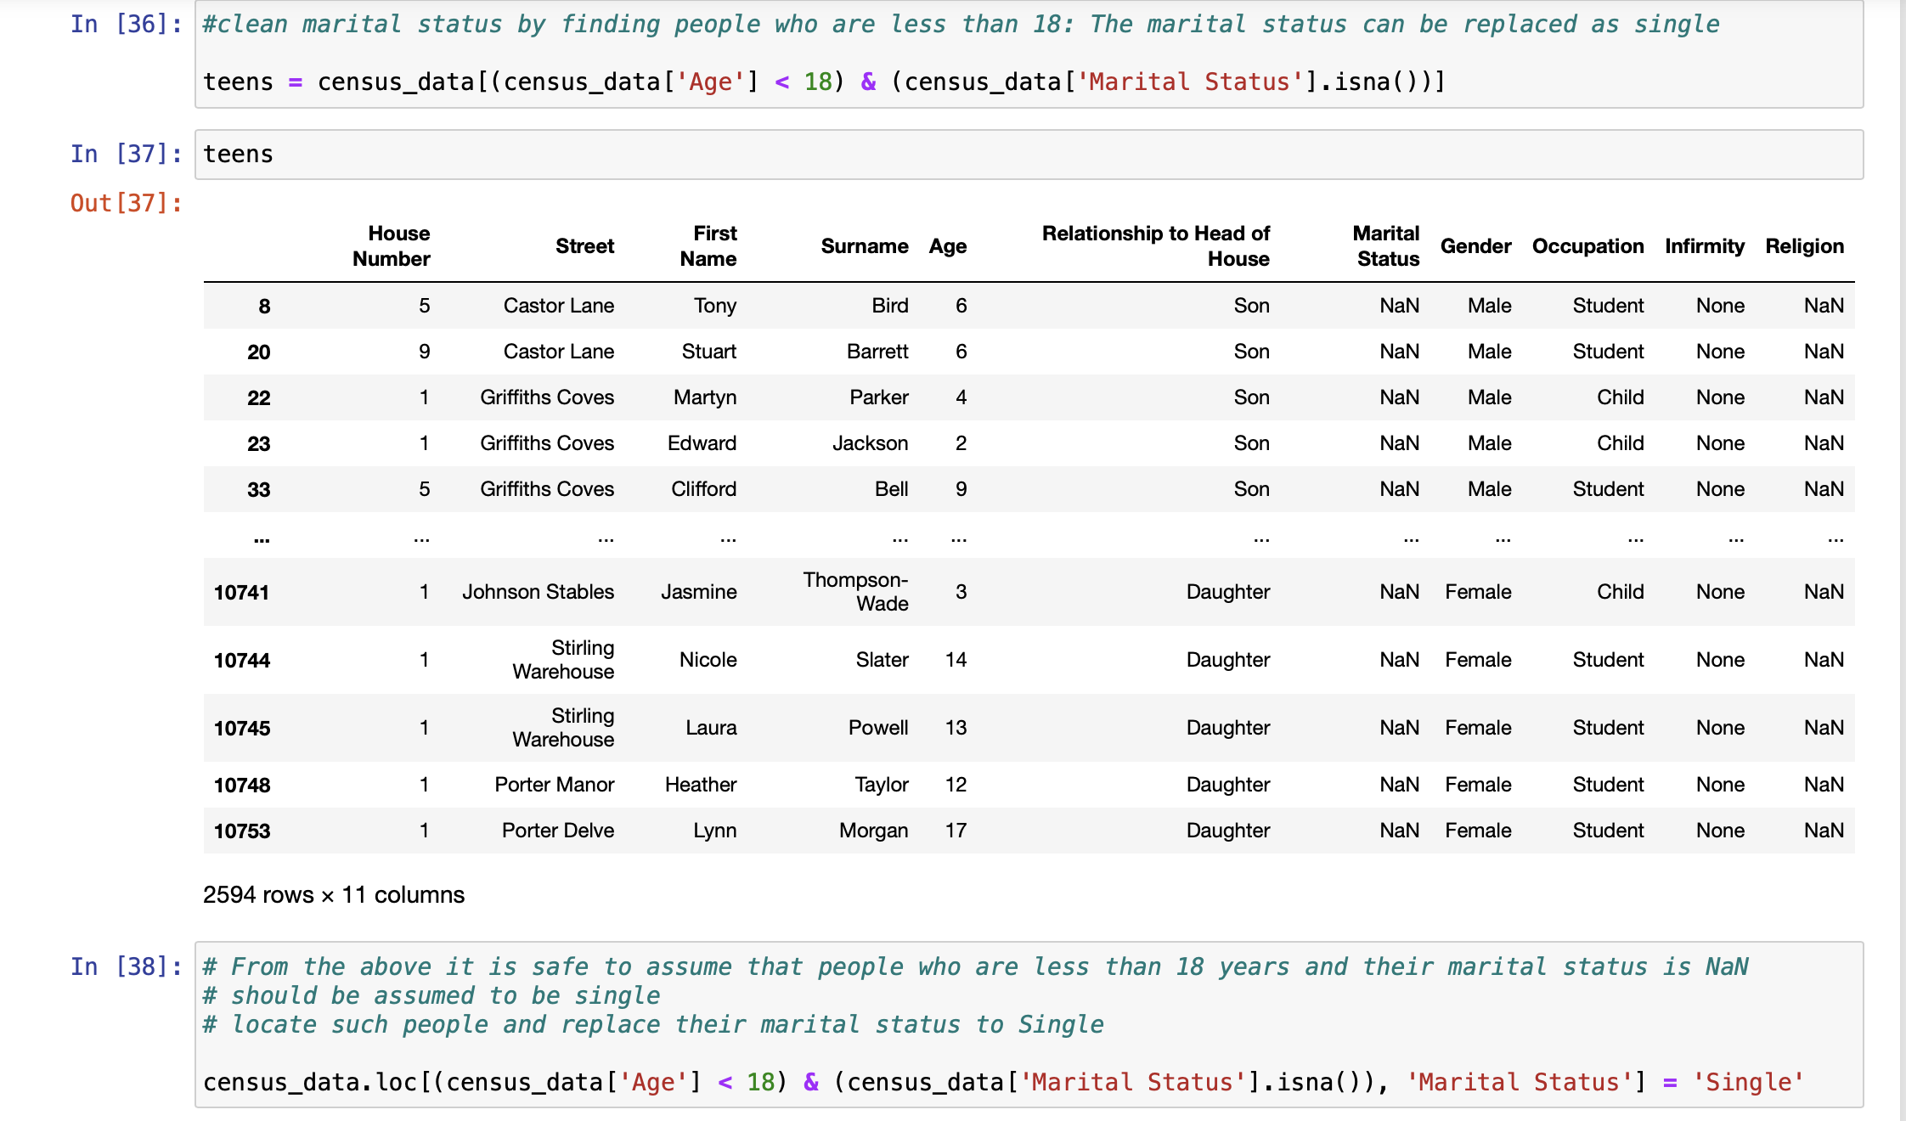
Cleaning Marital Status

Slide 8
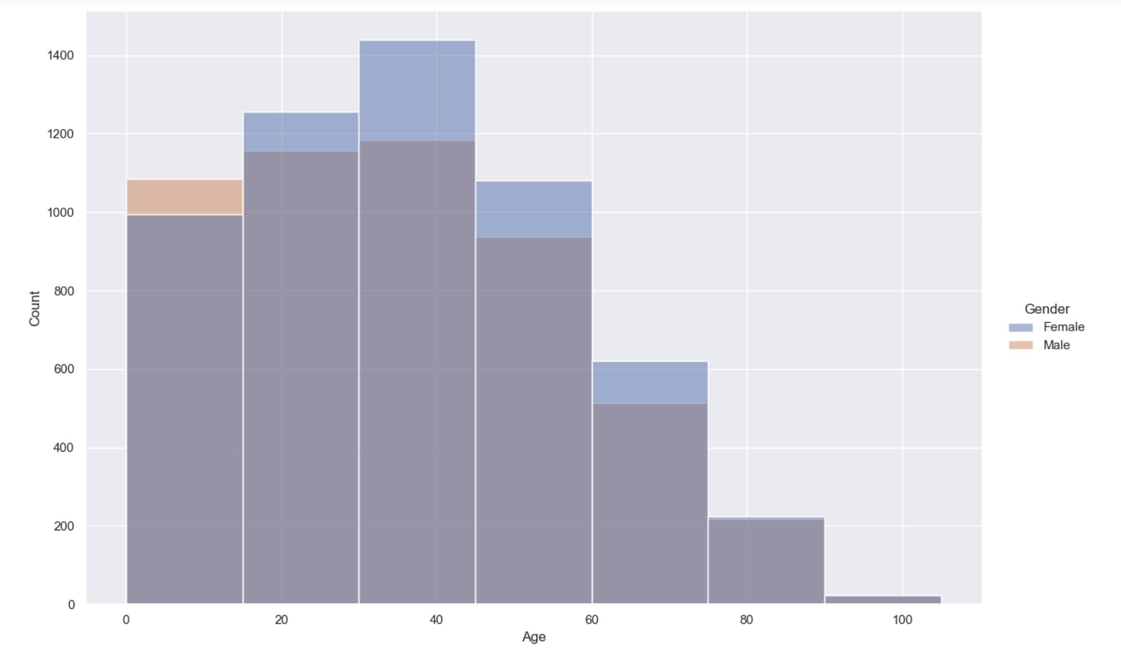
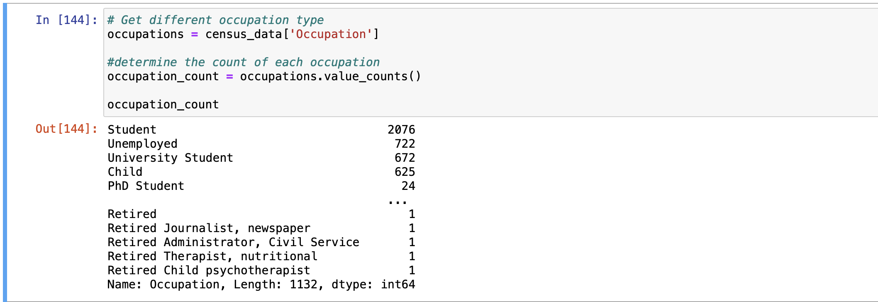
Data Insight There is Evidence of Unemployment
Investment in training and employment program will
Solve the problem

